Slide 1







Prayer
Attendance
Innovation
Energizer

Slide 2
DAILY
TASK
ICT
Prayer
Attendance
Innovation
Energizer
GROUP 6

Slide 3
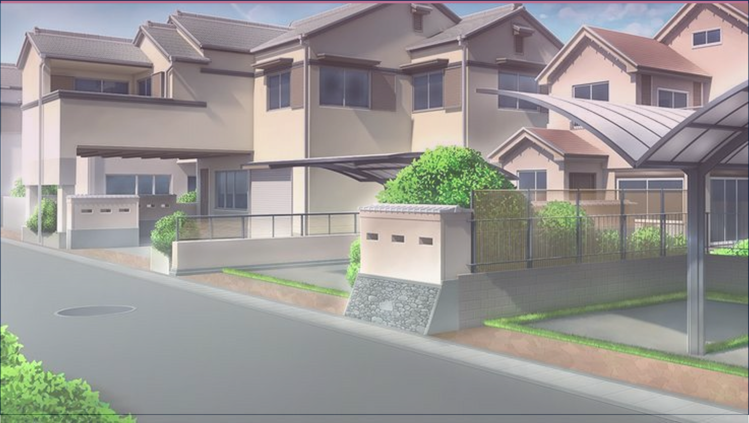
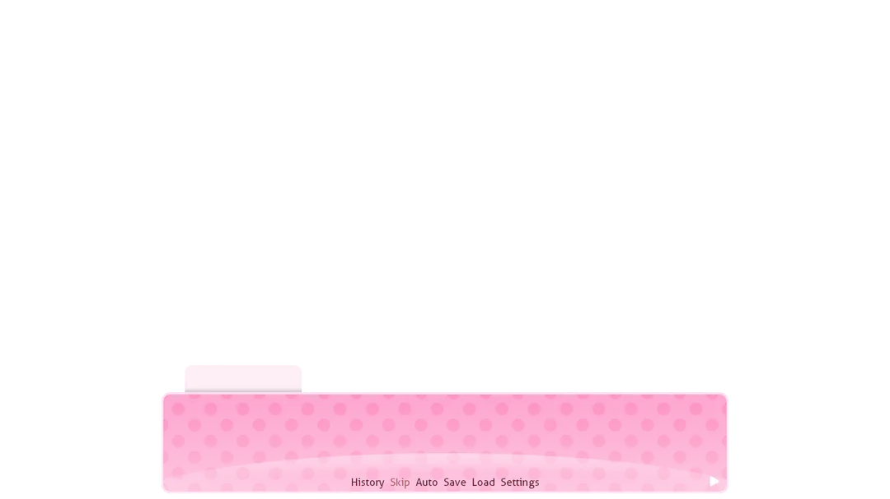

Ericsson Bagatan
Let us all stand for an opening prayer to be led by

Slide 4




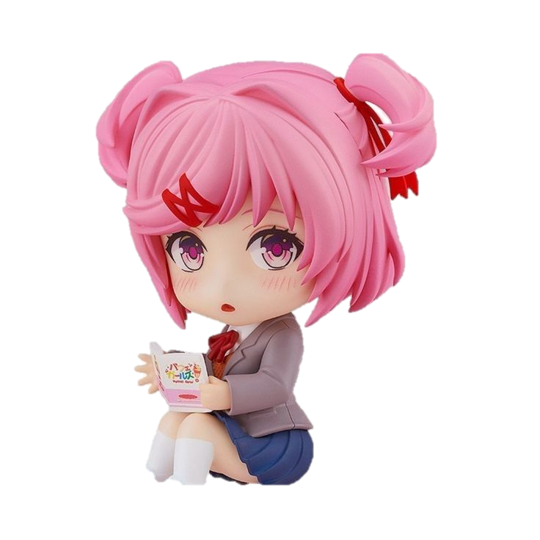
ATTENDANCE
Rhaizel Legaspi ⋆˚꩜｡

Slide 5



Innovation
( ˶°ㅁ°) !!
Picture here
PRODUCT NAME
Brief description
X
X
X
X
X
Presented by:
X
X
Bien Regala

Slide 6






x
x
X
x
x
x
x
x
x
ENERGIZER
x
x
x
X
x
x
x
x
Nathan Gumban
Just Monika.

Slide 7
x
x
X
x
x
x
x
x
x
ENERGIZER
x
x
x
X
x
x
x
x
Just Monika.
Nathan Gumban

Slide 8
x
x
X
x
x
x
x
x
x
ENERGIZER
x
x
x
X
x
Thank You for listening !
x
x
x
Nathan Gumban

